Slide 1


Computing in Context: Fall 2024
Lecture 4 | Clean code & debugging
Statistical brief overview
Dr Sarah Ashcroft-Jones | Mailman School of Public Health

Slide 2
Clean Code
Aka bad code stinks!

Slide 3
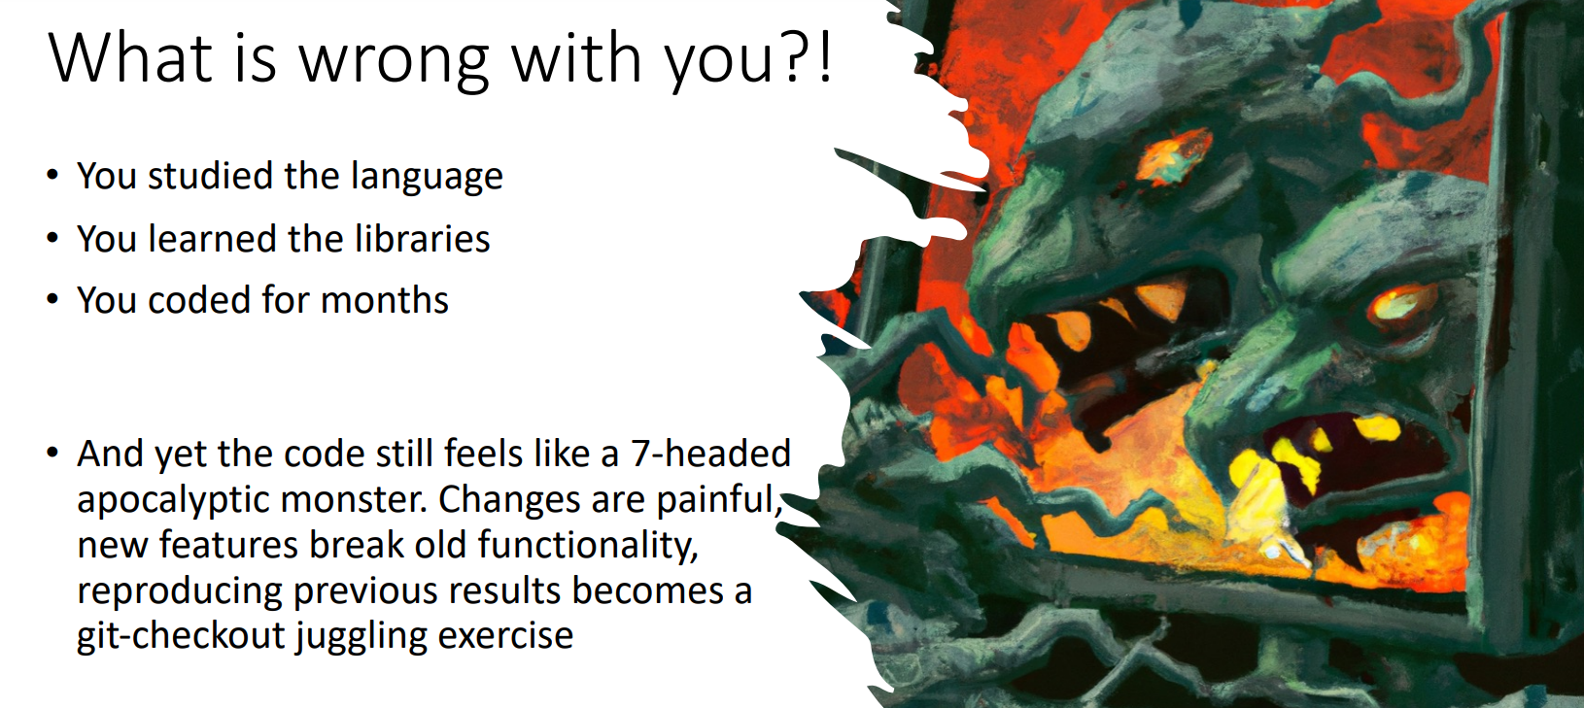
What’s wrong with you?
You studied the language
Learnt about all the modules
Practiced coding for weeks
But your code still feels like a 7 headed apocalyptic monster.
Notes:
Making changes is painful, adding new features breaks old functionality and reproducing old results is almost impossible.

Slide 4
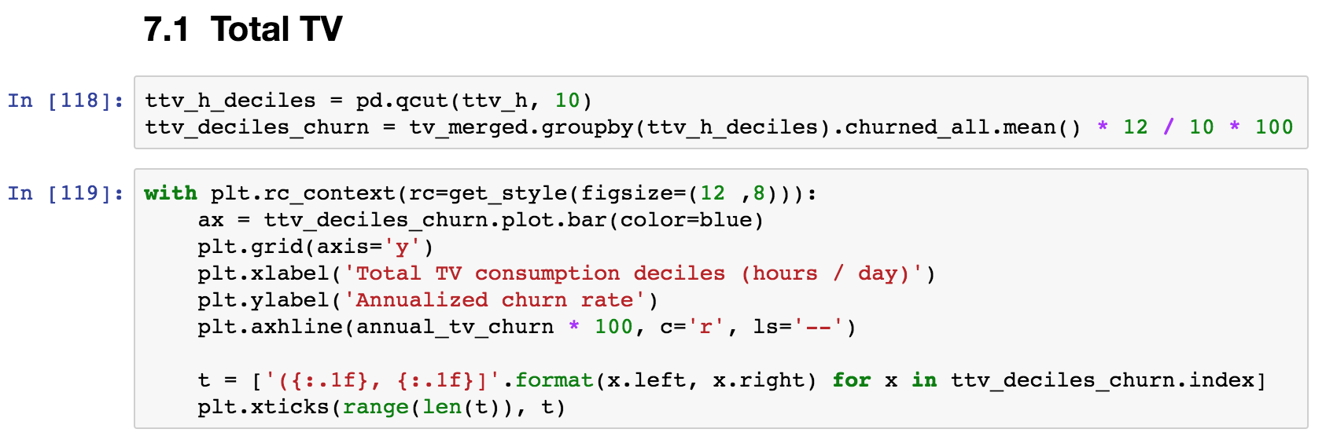
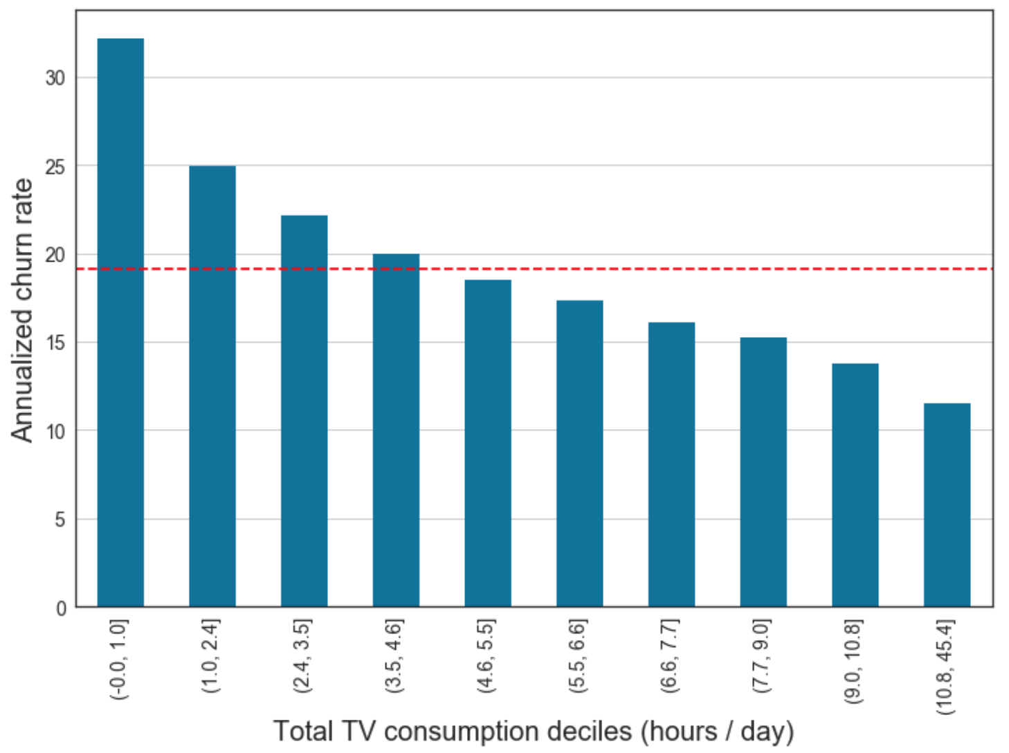
The good news: you can smell it

Slide 5
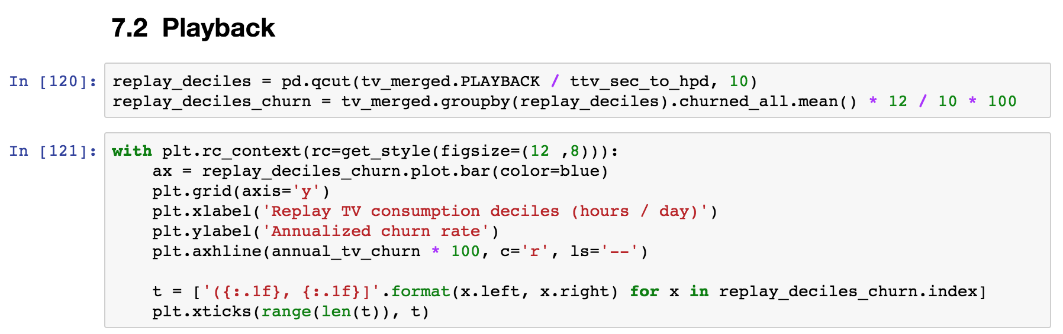
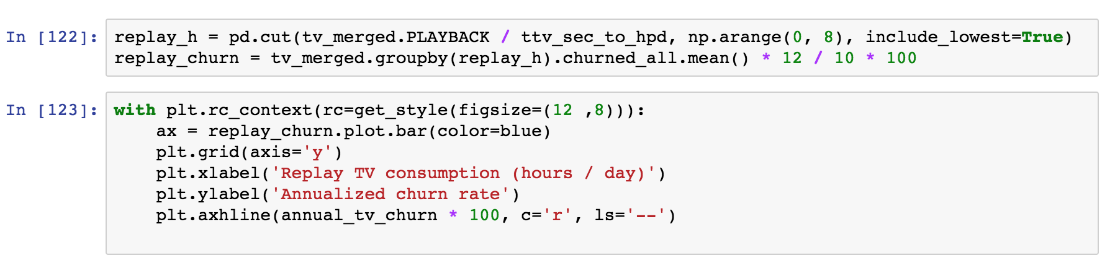
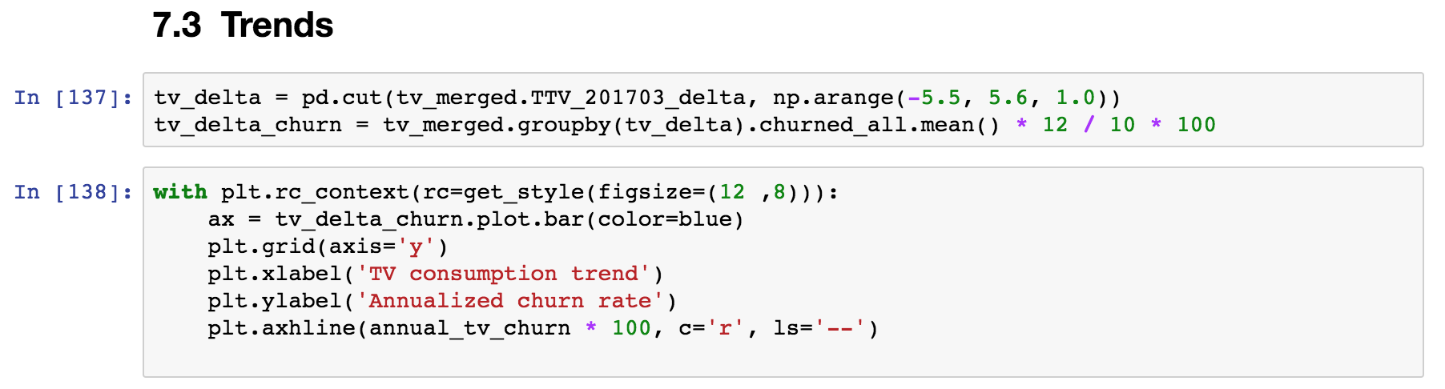
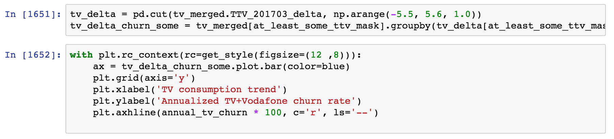
Because … this stinks!

Slide 6
What is wrong with smelly code?
It might work right now, but in time will have issues:
Hard to read & test: it is difficult to see an overall structure; understanding the code in one place requires checking the code all over
Coupled: an update in one place requires changes in other places
Not flexible: adding new functionality requires extensive rewrites
Notes:
So what should you have?

Slide 7

Code should be a Lego block structure
Functions (and classes) group together things that go together and form basic blocks.
We can quickly rearrange the blocks to extend a structure or build a new one!
Flexible code is just like a Lego construction:
is easy to understand in terms of blocks
tolerates changes
is reusable
Notes:
These constructs are not very common in scientific code, and you don’t actually ”need” them. But the same is true of functions!

Slide 8
More broadly …

Slide 9
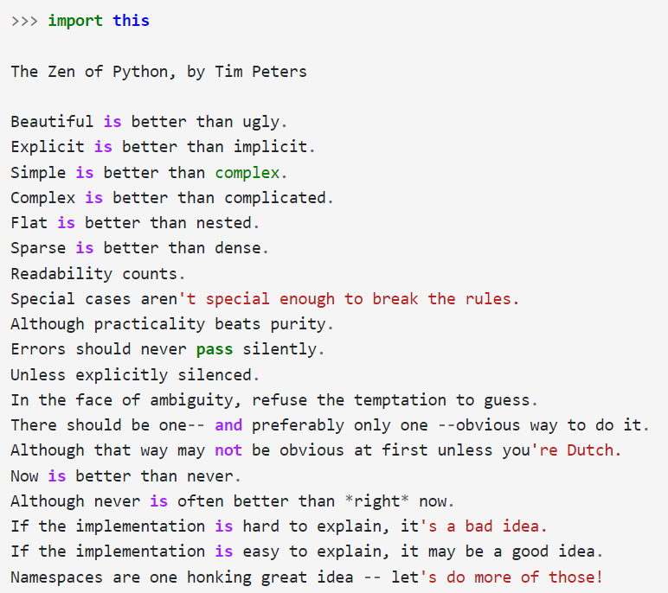
https://inventwithpython.com/blog/2018/08/17/the-zen-of-python-explained/
Notes:
19 "guiding principles" for writing computer programs in Python. The collection was written in 1999 by software engineer Tim Peters. It's included as an Easter egg in the Python interpreter.
Guido van Rossum, the creator and BDFL (Benevolent Dictator for Life) of Python, is Dutch.

Slide 10
Coding principle 1
DRY (Don't repeat yourself)
Every piece of knowledge must have a single, unambiguous, authoritative representation within a system.
Only rule is that code should not be duplicated.
Instead of duplicating lines, find an algorithm that uses iteration.

Slide 11
Coding principle 2
KISS (Keep it simple, stupid)
Most systems work best if they are kept simple, rather than made complicated.
Simplicity should be a key goal in structuring your code, and unnecessary complexity should be avoided.

Slide 12
Coding principle 3
SoC (Separation of concerns)
A design principle for separating a computer program into distinct sections such that each section addresses a separate concern. A concern is a set of information that affects the code of a computer program.
For example: create a new module when it makes sense to do so.
But - more modulesmay equal more problems – do you need another?

Slide 13
Clean code in practice
It’s the little things

Slide 14
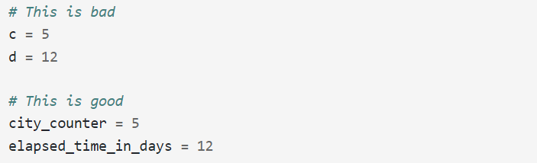
Naming conventions - variables
Make names easy to understand

Slide 15
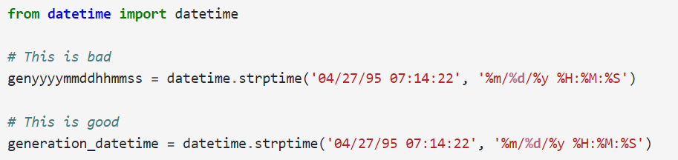
Naming conventions - variables
Make names pronounceable

Slide 16
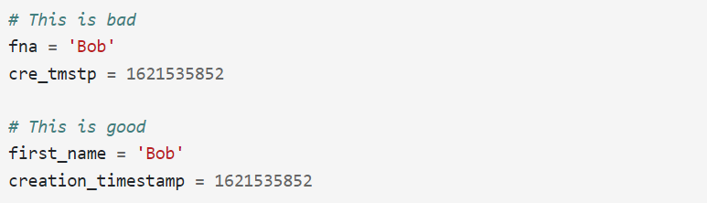
Naming conventions - variables
Avoid weird abbreviations

Slide 17
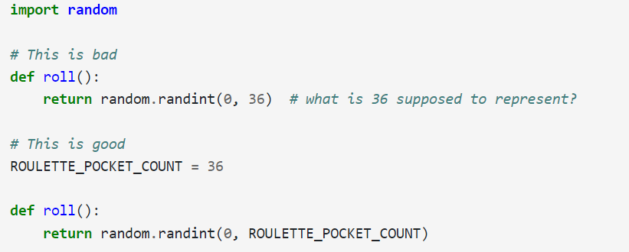
Naming conventions - variables
Avoid “magic” numbers

Slide 18
Commenting conventions

Slide 19
Commenting conventions
1. Don't comment bad code, rewrite it

Slide 20
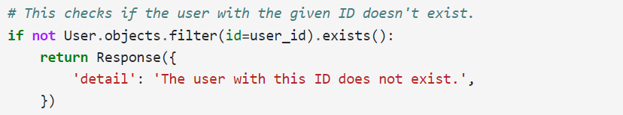
Commenting conventions
2. Readable code doesn’t need comments

Slide 21
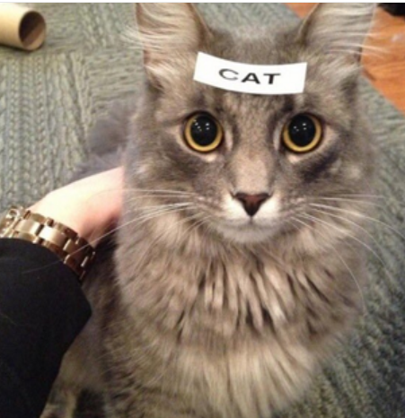
Commenting conventions
2b. Don't add comments that do not add anything of value to the code.

Slide 22
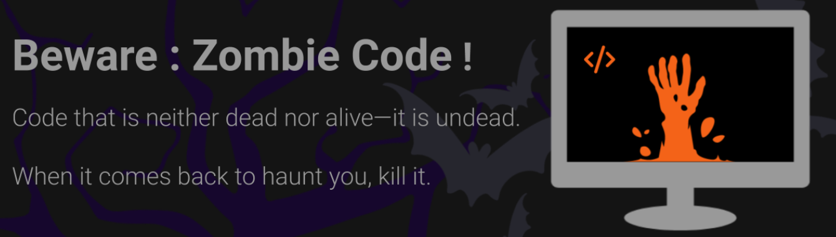
Commenting conventions
3. Don't leave commented out code

Slide 23
There’s a PEP for that!

Slide 24
There’s a PEP for that!
PEP 8 (Python Enhancement Proposal) a style guide that describes the coding standards for Python.
The most important rules work to guide:
- naming conventions
- line formatting
- whitespace
- comments
There’s a PEP for everything – we could get picky but just be consistent!

Slide 25
Get your PEP on: https://peps.python.org/pep-0008
1. If you have an acronym in camel case, should you capitalize the first letter only or the whole acronym?
2. How many blank lines go before a function I define at the top of a module? How many after?
3. Which of these is correct: x[3:4] or x[3 : 4]?
4. How many spaces should you use after a period in a comment?
5. Give examples of a long line of code and how you can break it onto multiple lines.
__________________________________________________________________________________________________
1. What are the capitalization guidelines for classes, functions, and variables? Give examples.
2. Should you use single or double quotes to indicate strings?
3. What is the difference between mixed case, camel case, and snake case?
4. How should you indicate block comments?
5. What are the whitespace rules around operators? Give several examples.

Slide 26
Debugging Code
Your very own Frankenstein’s monster!

Slide 27
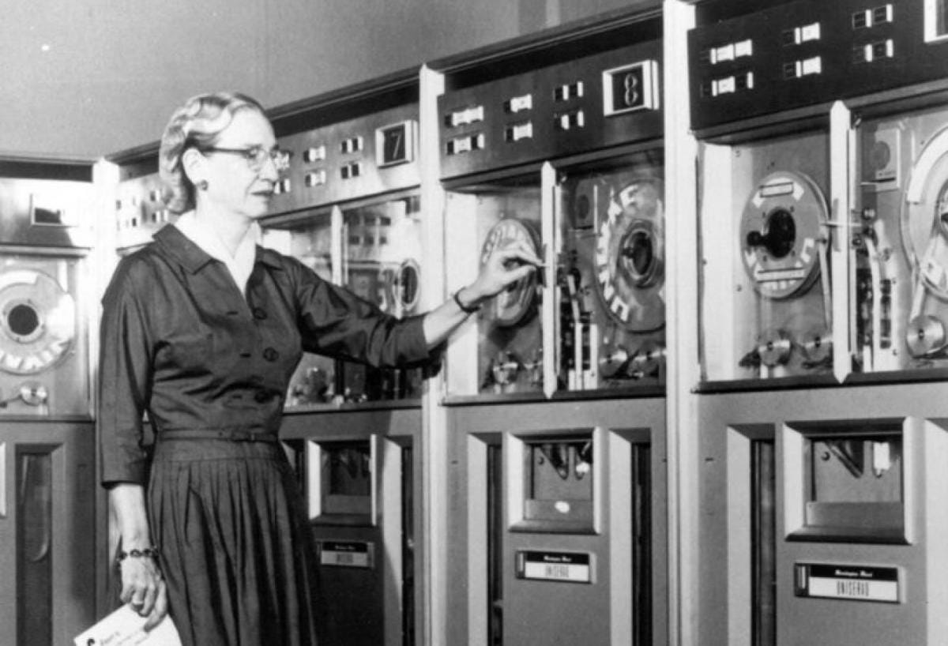
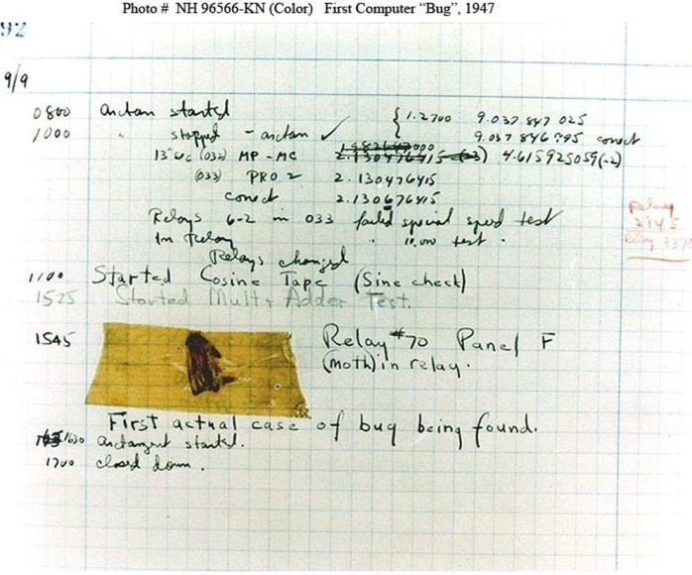
Where does “debugging” come from?
Team around Grace Hopper at Harvard found a moth in their computer in 1947 in maybe the first description of a computer bug.

Slide 28

And where do “bugs” come from?

Slide 29
The subtle art of debugging your code
(Sometimes, there is nothing subtle about it – but we can try!)

Slide 30
The subtle art of debugging your code
1. Know when to debug
For some, programming and debugging are the same thing. Programming is the process of gradually debugging a program until it does what you want.
Start with a simple piece of working code and make small incremental modifications, debugging as you go.
If you spend a lot of time debugging, you are writing too much code before you start testing!

Slide 31
The subtle art of debugging your code
2. Know your errors
Syntax error: “Syntax” refers to the structure of a program and the rules about that structure. If there is a syntax error in your program, Python does not run. It displays an error message immediately.
Runtime error: If there are no syntax errors in your program, it can start running. But if something goes wrong, Python errors out (aka an exception) and stops.
Semantic error: Code runs without generating error messages, but it does not do what you intended. Identifying semantic errors can be tricky because it requires you to work backward trying to figure out what it is doing.

Slide 32
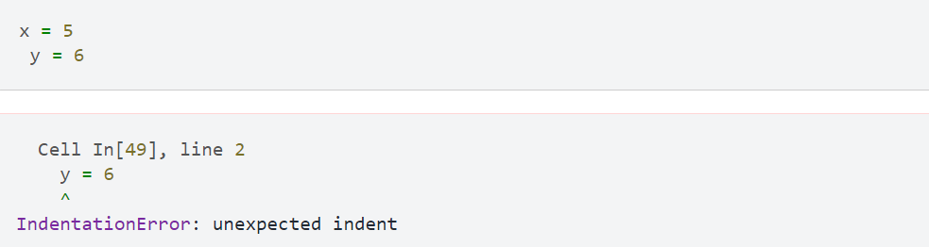
The subtle art of debugging your code
3. Know your error messages – what and where?
Notes:
A syntax error – code won’t run (won’t start to execute)

Slide 33
The subtle art of debugging your code
3. Know your error messages – what and where?
Notes:
A runtime error (will start to execute but then will lose

Slide 34
The subtle art of debugging your code
3. Know your error messages – what and where?
Notes:
Semantic error

Slide 35
The subtle art of debugging you code
4. If in doubt – print it out.
Viewing a variable via print()
Checking on a pandas dataframe using .head()
A great way to visually check on things (find those semantic errors!)

Slide 36
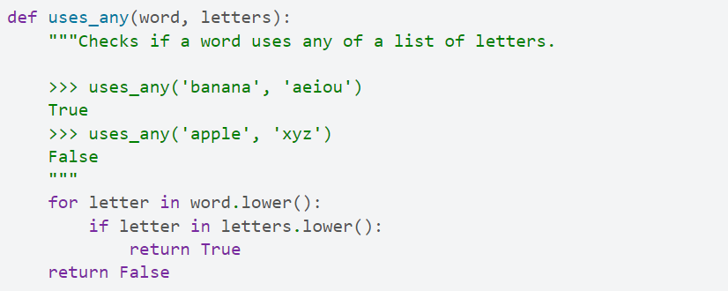
The subtle art of debugging you code
5. Build in bug repellant – via testing

Slide 37
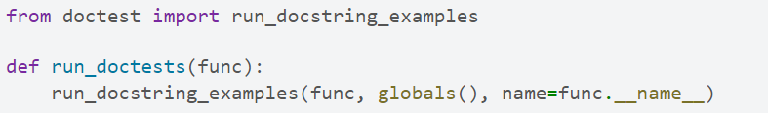
The subtle art of debugging you code
5. Build in bug repellant – via testing

Slide 38
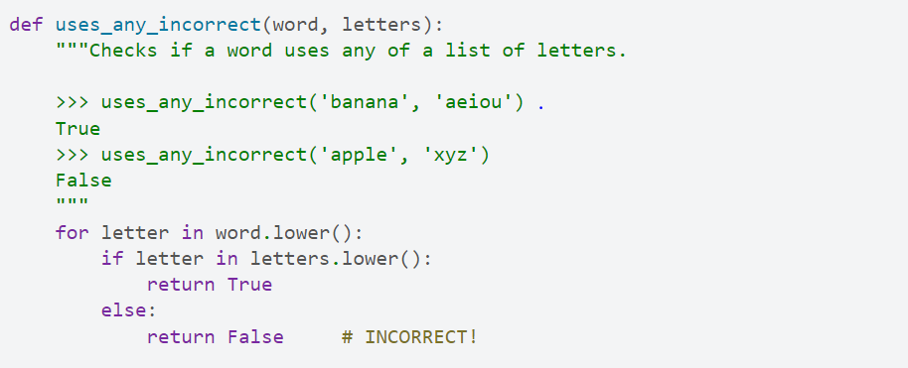
The subtle art of debugging you code
5. Build in bug repellant – via testing

Slide 39
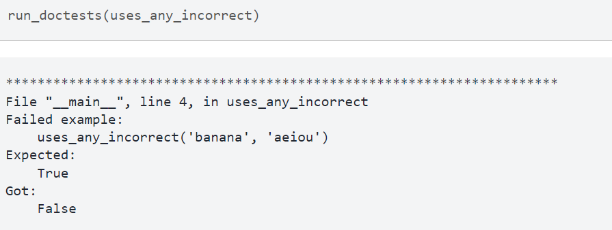
The subtle art of debugging you code
5. Build in bug repellant – via testing

Slide 40
The subtle art of debugging you code
6. Use an IDE debug mode or explore pdb in the command line…
https://docs.spyder-ide.org/current/panes/debugging.html

Slide 41
The subtle art of debugging you code
7. Keep it small keep it simple (when dealing with big data!)
Scale down the input.
Check summaries and types.
Write self-checks: e.g., if computing an average, check that the result is not greater than the largest element or less than the smallest.
This is a “sanity check” because it detects results that are “insane”.

Slide 42
Sharing Code
Sharing is caring!

Slide 43


Slide 44
Questions?
Proposal Memo due Monday at 5pm
Statistical brief overview
Dr Sarah Ashcroft-Jones | Mailman School of Public Health

